Slide 1



Back button
App icon
Account username
Username
Account password
Password
Submit credentials for validation
Log in

Slide 2

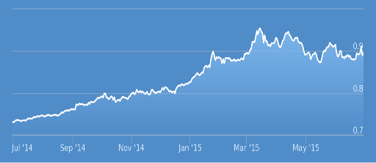
Toggle side menu
Link to profile
Link to admin chapter
Chapter
1, 000
Total lesson module
Link to admin lesson module
Lesson
Link to admin pre test
Activities
1, 210
Total students
Link to admin post test
Pre-test
Link to admin activities
Post-test
90%
Top Score
Link to admin accounts
Accounts
Log out account
Logout
Usage graph

Slide 3
Toggle side menu
Link to profile
1, 000
Total lesson module
1, 210
Total accounts
Contents will based on actual app
90%
Top Score
Usage graph

Slide 4
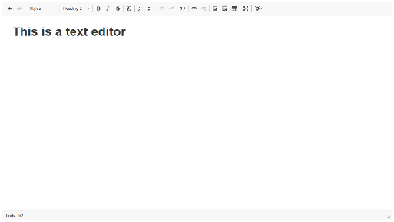
Toggle side menu
Link to profile
Adding of lesson
Lesson title
Dropdown (Chapter)
Lesson title
Lesson content
Button to save created lesson
Save
Lessons
Link to actual question
Sample lesson

Slide 5
Toggle side menu
Link to profile
Adding of Chapter
Chapter title
Lesson title
Save
Button to save created chapter
Chapter List
Sample lesson
Link to actual Chapter

Slide 6



Toggle side menu
Adding (test title)
Link to profile
Dropdown - lessons
Test question (Froala Editor)
Check if it is correct answer
Dropdown - question ranges
Dropdown – question type
Dropdown – difficulty
Test question
Test answer
Draggable for positioning (first = a)
Answer 1
Answer 2
Answer 2
Button to save created test
Save
Test questions
Link to actual question
Sample question

